Slide 1

A green vector for Moldova's agri-food sector
SAMRS/2023/ST/MD/1/2
Meeting with the Ambassador of the SR to the Republic of Moldova 29 November 2023, Chisinau

Slide 2








Slide 3
Project partnership
Applicant:
Slovak Centre for Communication and Development, n.o.
Partner Slovakia:
ArTUR, civic association
Partners Moldova:
Katalyst, civic association, Riškova (Central hub)
Apiprodex SRL, Ungheni, Todireşti (West hub)
Eco-Vego-Cris SRL Sîngerei, (North hub)
Consult SRL, Criuleni (East hub)

Slide 4
Strategic documents
Sectoral priorities
Medium-term Strategy for Development Cooperation of the Slovak Republic for 2019-2023
Supporting the creation of a market environment
Infrastructure and sustainable use of natural resources
Sustainable Development Goals
SDG 2 - Eliminate hunger
SDG 8 - Decent work and economic growth
SDG 9 - Industry, Innovation and Infrastructure
SDG 12 - responsible consumption and production
SDG 5 - Gender equality (cross-cutting theme)
SDG 13 - Climate protection (cross-cutting theme)

Slide 5
Baseline situation
Dependence of MD on energy imports from RU and UA
Dependence of the economy on agriculture and agricultural exports - underdeveloped rural regions, employment hl. in pp., low wages
  (1) poverty, (2) weak infrastructure development, (3) lack of employment opportunities, and (4) underdeveloped markets
Climate change - shift to dry sub-humid and semi-arid zones - impact especially on rural areas
War in UA - energy crisis, influx of UA refugees
Status of rural women - financial dependence, inequality of opportunity and domestic violence, single mothers (migration)

Slide 6
Identified needs and solutions
Survey in Moldova - interviews and questionnaires
Experience from the implementation of the SlovakAid project "Agri-food incubator as a catalyst for entrepreneurial innovation in the regions of Moldova" (2020-2022)
Experience from the implementation of the V4 Moldova ECO-AGRO-FOOD project New Perspective Agriculture (Visegrad Fund)
financial security and independence, specifically for women - entrepreneurship, deployment of smart solutions and value-added techniques,
access to communities and markets for sale - support for distribution and promotion,
Sustainable access to energy and natural resources - renewables and energy savings, ecological solutions (soil, water, waste, greenery and BD.), education,
protection from the impacts of climate change and the losses it causes - plans and implementation of resilience building measures

Slide 7
Project logic
Goal
Promoting Moldova's economic growth based on the sustainable use of natural resources
Specific objective
Promote environmentally sustainable agro-economy and food production that creates jobs and increases energy and food self-sufficiency in Moldova
  Development Centres - 6 models (MD partners)
  New jobs (36)
  Increased environmental awareness (100 000)

Slide 8
Target groups
Rural farmers, food producers and entrepreneurs in agriculture and food processing in 4 MD target regions (Chisinau and Riscova /C, Singerei /N, Ungheni /W and Criuleni /E) +2 (S and E)
  Focus on women - empower rural women and opportunities to secure their own socio-economic independence
Communities - youth, UA refugees, public and sector organisations, public
  Supporting the implementation of activities and contributing to overall project impact and sustainability

Slide 9
Cross-cutting themes
Gender equality
Category B: Positive impact on gender equality
focusing on the development / establishment of small and micro-enterprises and start-ups in agrc and agrifood in the regions - addressing women in particular and reflecting their needs,
Indicators - expected participation of 80% women (confirmed in previous project).
Environment and climate change
Category B: no risk, only opportunity
focus on improving the aspects monitored

Slide 10
Intervention scheme
Information
capacities + production and distribution networks
investment
cooperation and partnerships

Slide 11
Results and indicators
Demonstration of environmentally and climate resilient solutions for agrc. and agrifood businesses - direct investments (10 measures - renewable energy and savings, land degradation, water retention, 18 businesses - agroecology, also shared infrastructure; 6 partners - green and biodiversity)
Development of production and distribution capacities - training, development and sales support (development and establishment of SMEs and start-ups - 58, 800 people with improved practical skills, 4 measures - digital economy)
Increased awareness of sustainable use of natural resources and climate resilient solutions in the agrc. and agrifood sector (communities - 6 hands-on events, 129 people, 4000 trees; 5 schools, 11 institutions; 8 action plans on CC, 5 campaigns)

Slide 12
Activities
A1. Strengthening productive capacity through investments in sustainable use of natural resources and shared infrastructure.
  Phase 1 - 4 hubs = 4 MD partner organisations; specifically based on needs
  Phase 2 - 2 hubs , selection within the call + pre,networking (J, V)
A2. Capacity building
  Trainings and workshops, continuous couching, online educational materials
  Themes for the pp and ap sector 1) agroecology, 2) business development, 3) sustainability in agri-food, 4) digital technologies, 5) energy efficiency and renewable resources, 6) eco-construction, 7) sustainable production and consumption for youth, 8) integration of people with special health needs
  In each hub, focus according to needs, exchange of professional knowledge and experience
A3. Building production and distribution networks around regional hubs
  Promotion of sales of agrc and agrfood products - markets, festivals, online sales, sales and promotion points in Chişinău and Riškova
  Connecting growers and processors, expanding cooperation and growing the hub

Slide 13
Activities /cont.
A4. Building awareness and strengthening sustainability
  5 campaigns - different levels and target groups
  national level: a) the general public, with a focus on responsible consumption, b) farmers and agri-food producers, with the intention of disseminating and replicating the project results
  Regional level: c) marketing campaigns for hubs´ products, d) workshops in schools, e) community events to implement practical measures to promote greening and biodiversity.
  Forms: online campaign, educational workshops with children, practical implementation in communities
  Dissemination of results and cooperation with associations, municipalities, state institutions
A5. Building strategic partnerships between SK and MD in the business sector
  6 missions in MD + 1 study trip to SK
  8 action plans: mitigation and adaptation to CC - energy efficiency and green building (new area with the prospect of further interventions)

Slide 14
Sustainability
Creation and strengthening of a functional national network of development centres - several regions in Moldova
  interconnections: info and know-how, mutual business activities
  production and sales support
Development based on ecological principles - sustainable use of natural resources, resilience to CC
  demonstrations + usability of investments in a network of centres
  Education
Dissemination of results
  Liaison with key sector organisations and public administration representatives
  raising public awareness in Moldova

Slide 15
Risks
Negative socio-economic impacts of the military conflict in Ukraine
instability in the energy market, higher inflation rates, rising prices, UA refugees, threat of widespread conflict
Purchase of all key high-cost items at the beginning of the project, energy independence (green solutions), creation of a reserve fund, creation of a support network
Cautious attitude of project beneficiaries towards green solutions
requires more labour, usually more expensive, has limited sales in the emerging local market due to relatively low income levels, more expensive to export
Education on green solutions (changing the quality of production, eliminating the effects of climate change, increasing competitiveness by introducing low-energy solutions, European markets)
Demonstrate solutions based on local raw materials

Slide 16
Timetable
Phase 1: 1.8.2023 - 31.10.2025 (26+1m)
Phase 2: 28.2.2026 - 30.09.2028 (30+1m)

Slide 17
Budget - by category

Slide 18
Budget - by activity

Slide 19
project progress NOV 2023
A1. Strengthening productive capacity through investments in sustainable use of natural resources and shared infrastructure
  Energy saving measures in buildings
    Insulation of the production building - EAST hub Consult LC, Criuleni
    Ventilation system with heat recovery - EAST hub Consult LC, Criuleni
    Heat pump heating system - CENTRAL hub, Katalyst, Riškov (connected to purchased solar system)
    Heat pump heating system - WEST hub, Apiprodex, Ungheni (connected to purchased solar system)
  Food processing equipment for shared use
    Fruit dryer - WEST hub, Apiprodex, Ungheni; NORTH hub, Eco-Vego-Cris, Singerei
    Fruit/veggie seiving machine - CENTRAL hub, Katalyst, Riškov; NORTH hub, Eco-Vego-Cris, Singerei; EAST hub Consult LC, Criuleni
    Apple skin cleaner and ring cutter - NORTH hub, Eco-Vego-Cris, Singerei; EAST hub Consult LC, Criuleni
    Packager with modified atmosphere function - EAST hub Consult LC, Criuleni
    Bakery Oven for shared use - WEST hub, Apiprodex, Ungheni (connected to the purchased solar system)

Slide 20
project progress NOV 2023/cont.
A1. Strengthening productive capacity through investments in sustainable use of natural resources and shared infrastructure /cont.
Electric van for shared use w.charging station - CENTRAL Hub, Katalyst, Riškov
Professional photoamera w.zoom lens - NORTH hub, Eco-Vego-Cris, Singerei
facilities for sales promotion
  foldable tables and chairs for the farmers market - NORTH hub, Eco-Vego-Cris, Singerei
  foldable tents for the farmers market - NORTH hub, Eco-Vego-Cris, Singerei
facilities for production spaces
  Small processing machines - WEST hub, Apiprodex, Ungheni (Vacuum pump- forlyophilizer (Freeze dryer), cutter, universal mixer chocolate pots)

Slide 21
project progress NOV 2023/ cont.
A2. Capacity building
  Trainings and workshops, KM – not planned yet
A3. Building production and distribution networks around regional hubs
  Promotion of sales of pp and ap products
    Potato Fest 15 October 2023, CENTRAL hub, Katalyst, Riškova

Slide 22
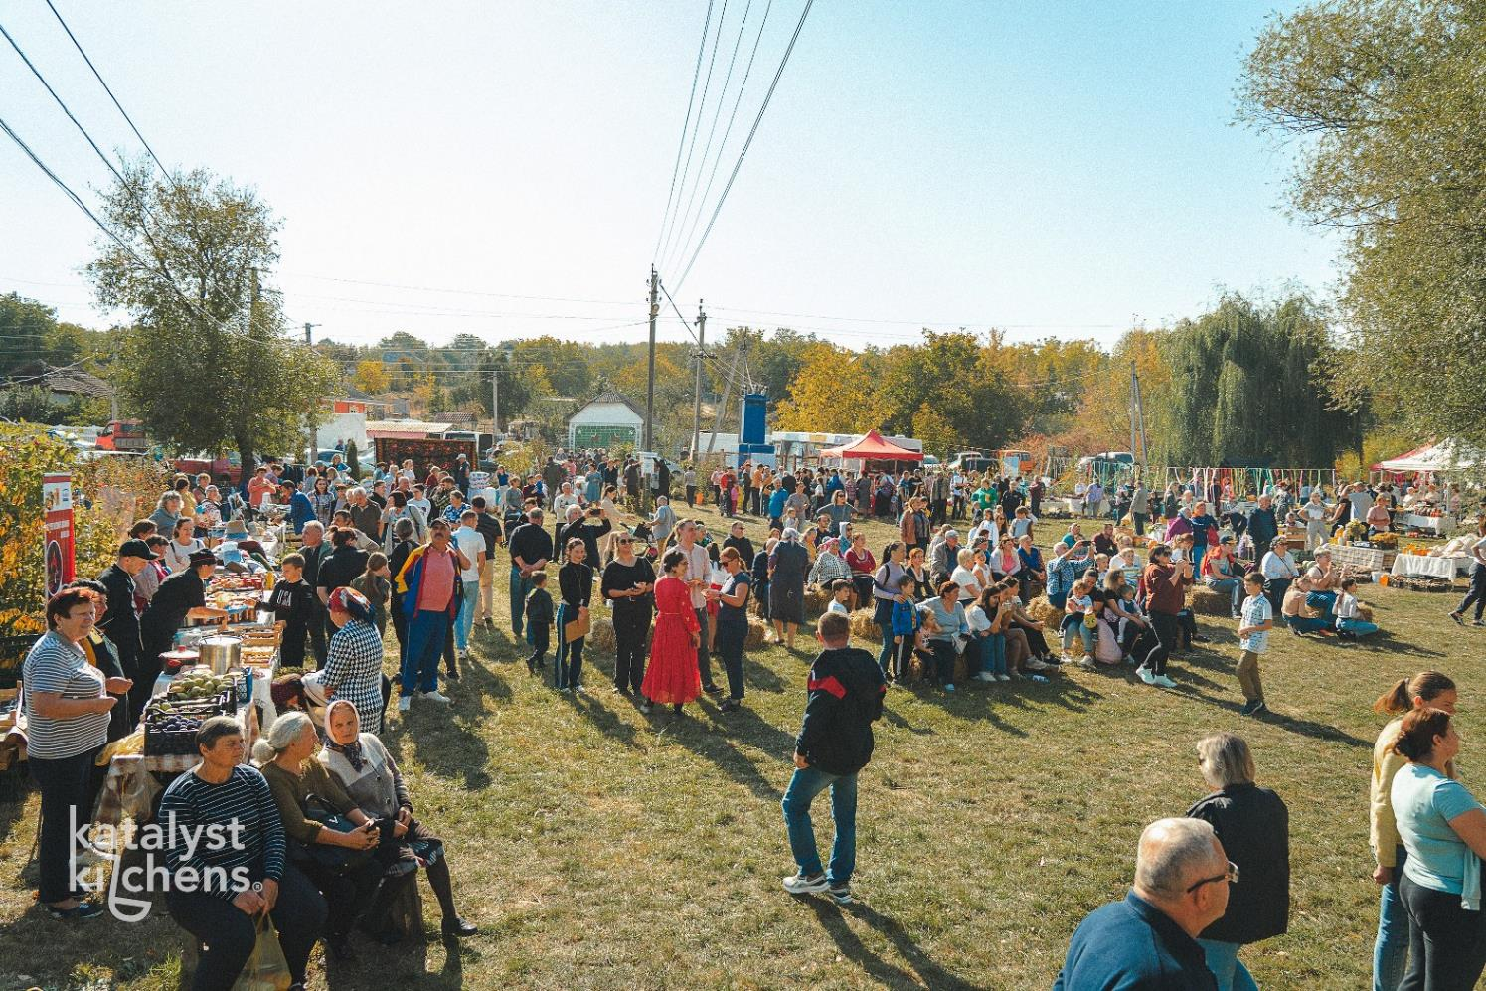

Slide 23
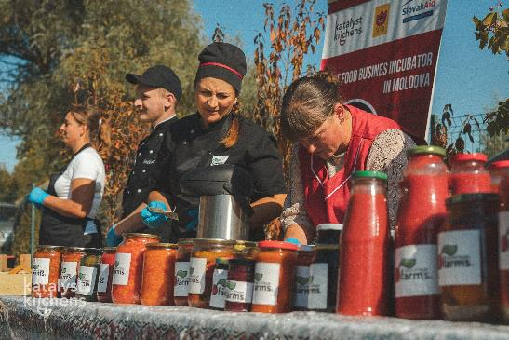

Slide 24
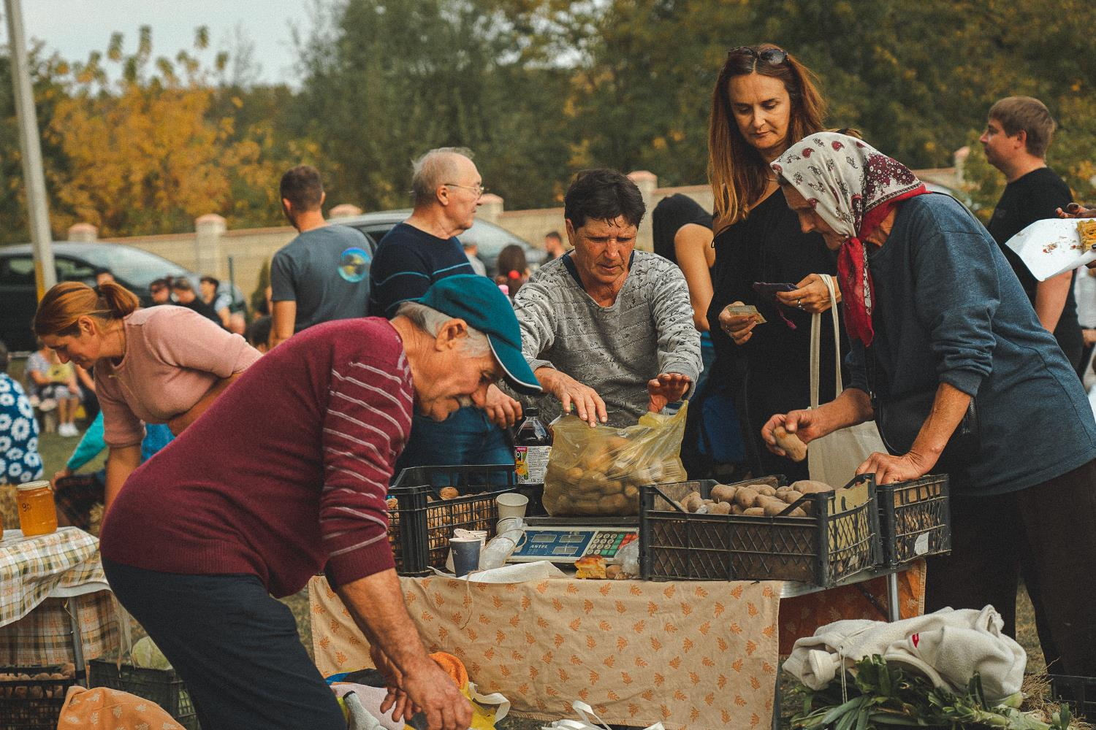

Slide 25
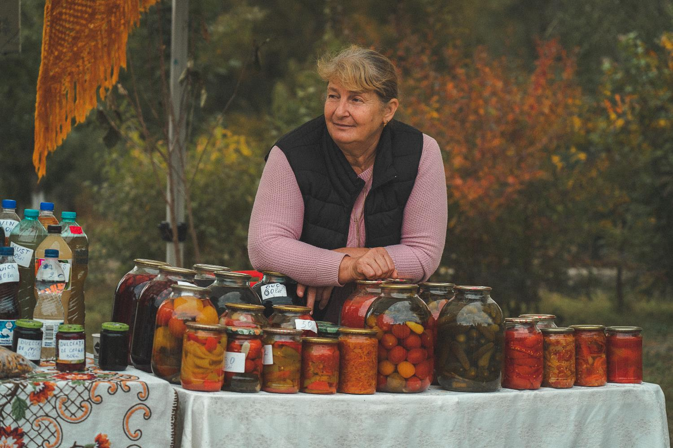

Slide 26
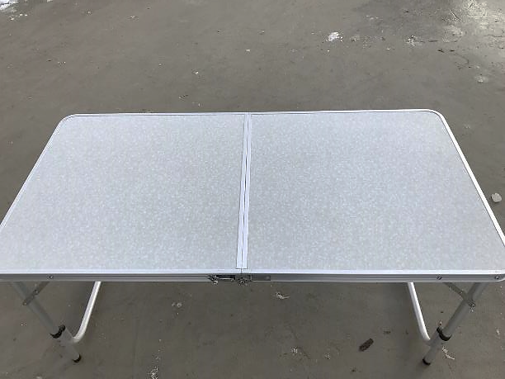
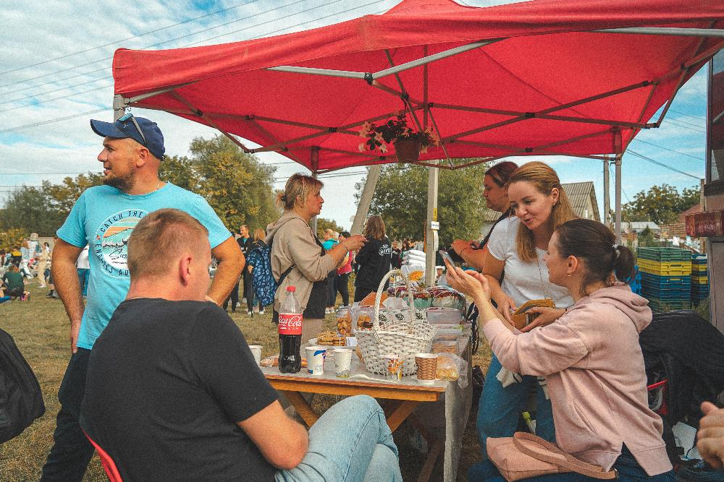
tables and tents for the North Hub, used for Potato Fest at Central Hub

Slide 27
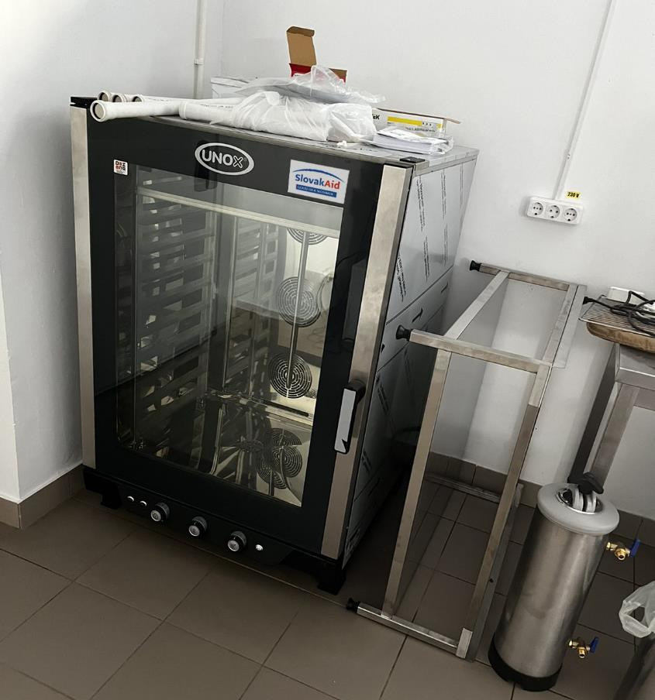
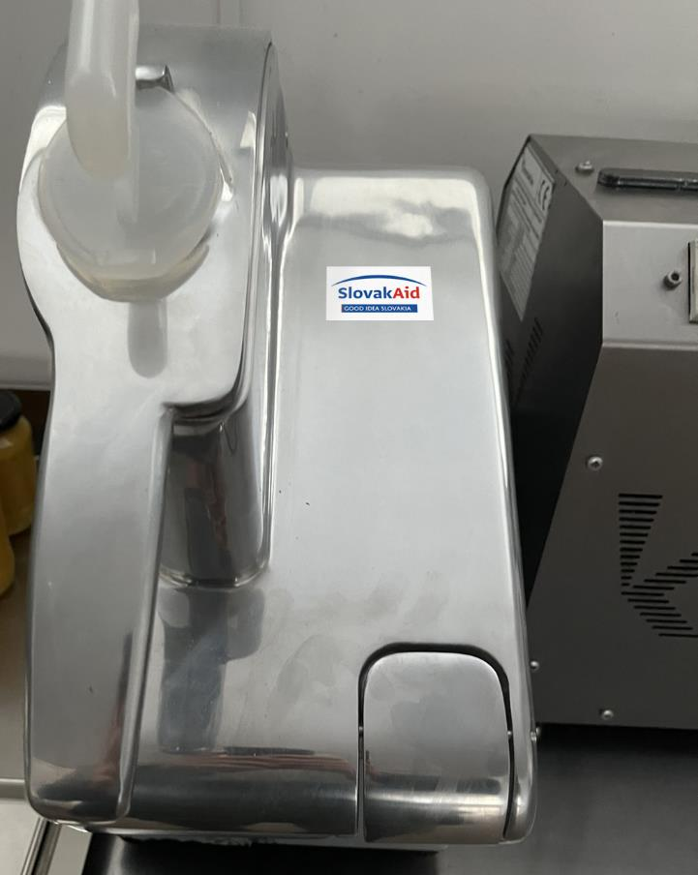
Processing equipment and heating system West Hub

Slide 28
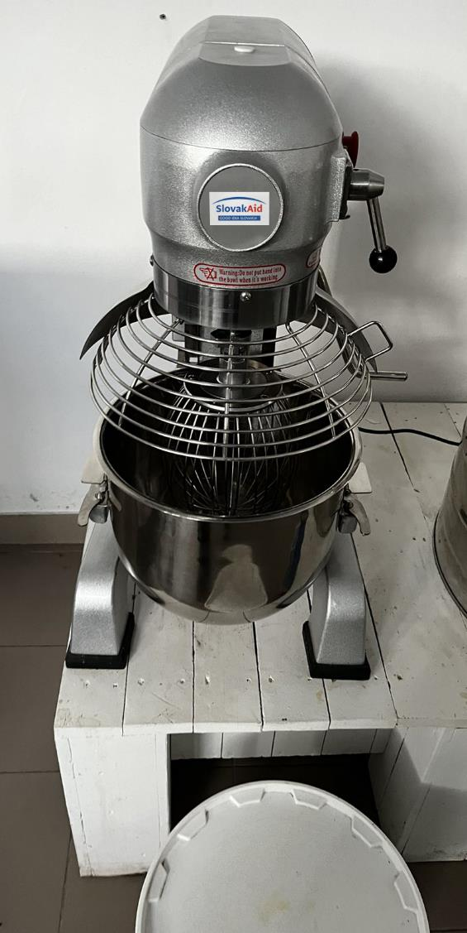
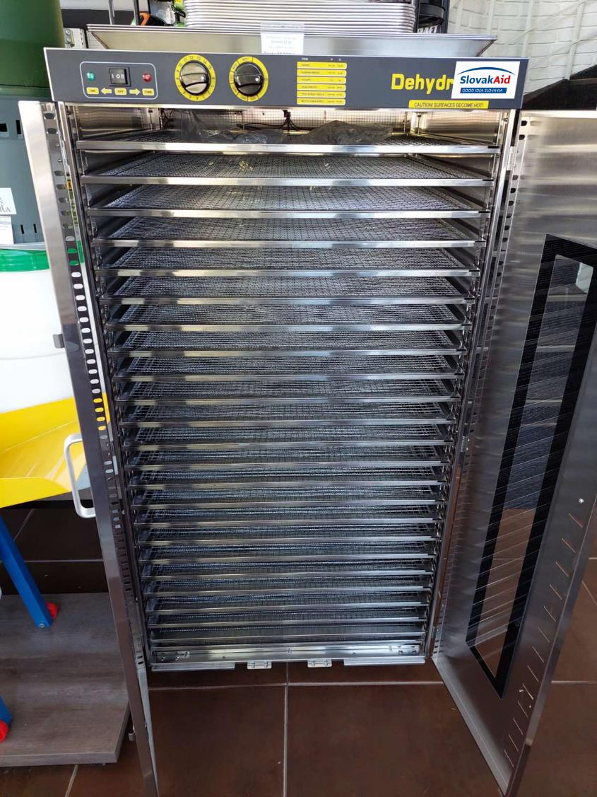

Slide 29
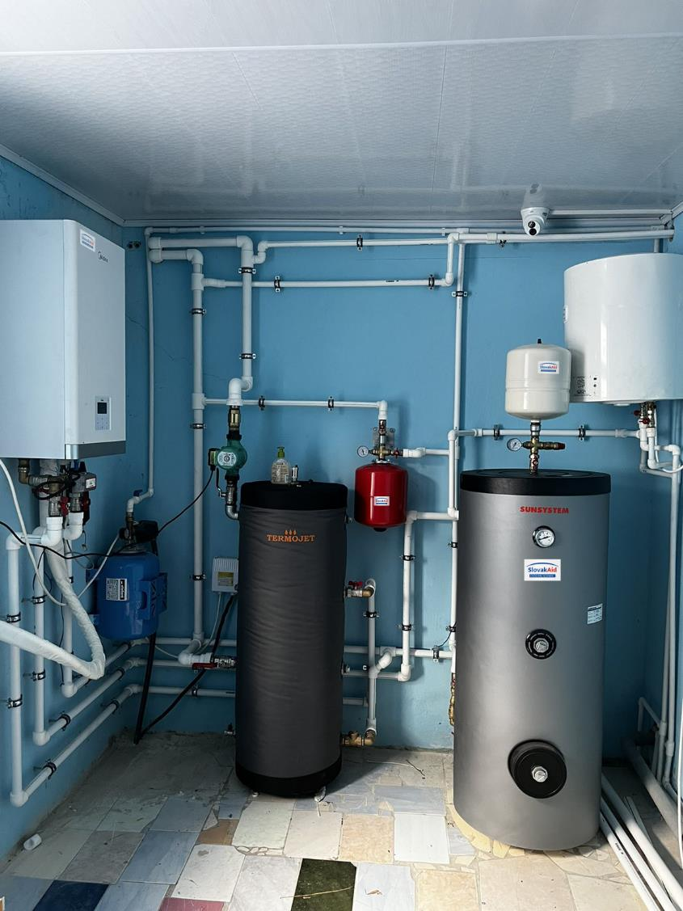

Slide 30
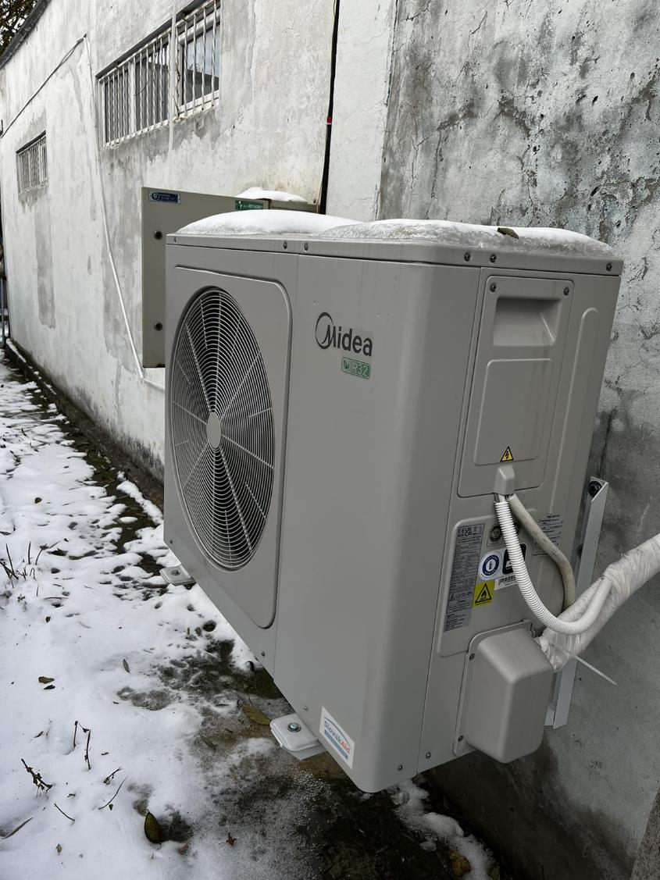
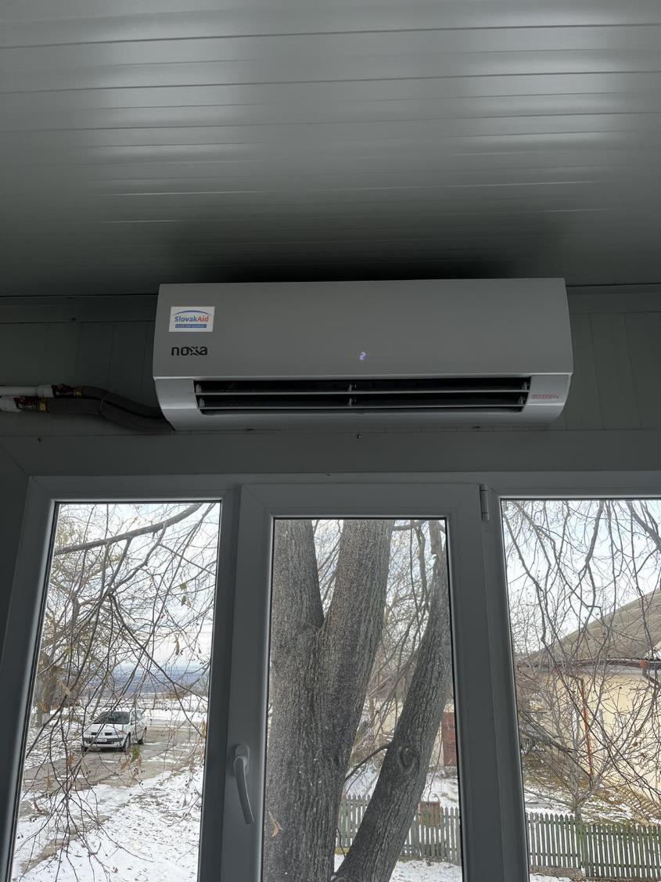

Slide 31
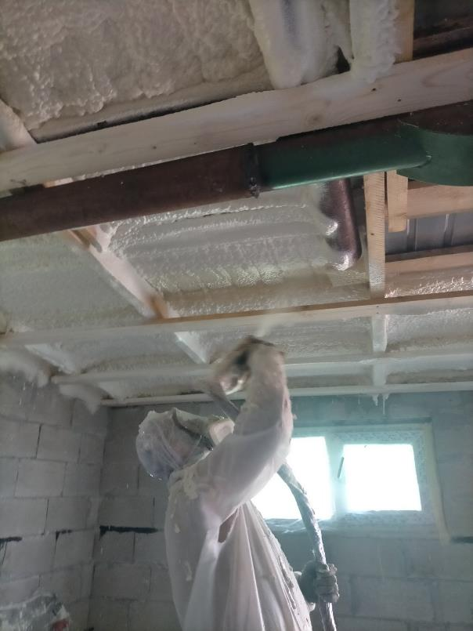
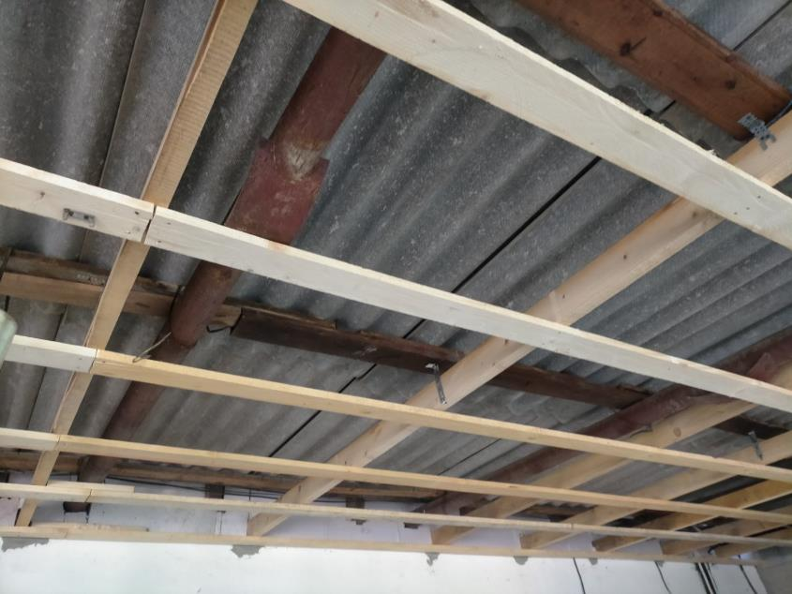
Insulation and ventilation at Eastern Hub

Slide 32
project progress NOV 2023/ cont.
A4. Building awareness and strengthening sustainability
  5 campaigns - different levels and target groups – in preparation
  national level:
  workshops in schools
  community events to implement practical measures to promote greening and biodiversity – purchase of trees.
A5. Building strategic partnerships between SK and MD in the business sector
  1st missionin MD – planned beginning 2024
  Identification of needs

Slide 33

Thank you for your attention!
Slovak Centre for Communication and Development (SCCD)
Prazska 11, 811 04 Bratislava, Slovakia
sccd-en.org
Zuzana Jezerská Klára Tóthová
Executive Director Project Manager
jezerska@sccd-sk.org tothova@sccd-sk.org

